Slide 1
Phases Of Compiler

Slide 2
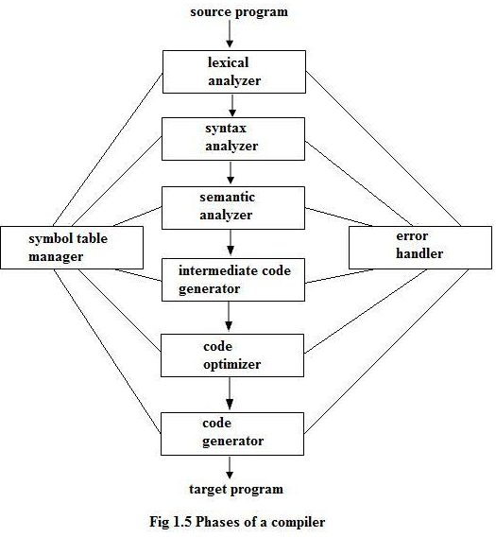
Steps For Phases Of Compiler

Slide 3
Lexical Analyzer
Lexical Analyzer reads the source program character by character and returns the tokens of the source program.
Groups the characters into meaningful sequences called lexemes
The output will be in the form of tokens.

Slide 4
Example of Lexical Analysis
position = initial + rate * 60
<id,1><=> <id,2><+><id,3><*><60>
position is a lexeme that would be mapped into a token <id,1>. where id is an abstract symbol standing for identifier and 1 points to the symbol able entry for position.
The assignment symbol = is a lexeme that is mapped into the token <=>.
initial is a lexeme that is mapped into the token <id, 2>.
+ is a lexeme that is mapped into the token <+>.
Rate is a lexeme that is mapped into the token <id, 3>.
* is a lexeme that is mapped into the token <*>.
60 is a lexeme that is mapped into the token <60>.

Slide 5
Syntax Analyzer
A Syntax Analyzer creates the syntactic structure (generally a parse tree) of the given program.
A syntax analyzer is also called as a parser.
A parse tree describes a syntactic structure.

Slide 6
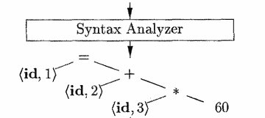
Example of Syntax Analyzer
position = initial + rate * 60

Slide 7
Semantic Analyzer
A semantic analyzer checks the source program for semantic errors and collects the type information for the code generation.
It ensures the correctness of the program, matching of the parenthesis is also done in this phase.
Type-checking is an important part of semantic analyzer.

Slide 8
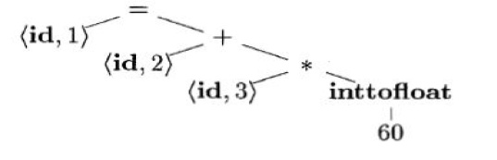
Example Of Semantic Analyzer
position=initial + rate*60

Slide 9
Intermediate Code Generation
A compiler may produce an explicit intermediate codes representing the source program.
The output -> three-address code sequence.
Example:
t1 = inttofloat (60)
t2 = id3 * t1
t3 = id2 + t2
id1 = t3

Slide 10
Code Optimizer
The code optimizer optimizes the code produced by the intermediate code generator in the terms of time and space.
Improve the efficiency of code so that the target program running time and consumption of memory can be reduced
Example
t1 = id3 * 60.0
id1 = id2 + t1

Slide 11
Code Generator
The code generator takes as input an intermediate representation of the source program and maps it into the target language.
Target language is machine code, registers or memory locations are selected for each of the variables used by the program

Slide 12
Example Of Code Generator
Registers R1 and R2, the intermediate translated into the machine code
LDF R2, id3
MULF R2, R2, #60.0
LDF R1, id2
ADDF R1, R1, R2
STF idl, R1

